Slide 1
COMP6056 Program Design Methods
Input, Processing and Output (Part 1)
Session 2
Jude J.L. Martinez
jmartinez@binus.edu

Slide 2
Session Learning Outcomes
Upon completion of this session, students are expected to be able to
Explain the program development life cycle, data types, variables and sequence structure

Slide 3
TOPIC: Input, Processing and Output (Part 1)

Slide 4
Chapter 2: Input, Processing, and Output
Starting Out with Programming Logic & Design
Second Edition
by Tony Gaddis

Slide 5
Chapter Topics
2.1 Designing a Program
2.2 Output, Input, and Variables
2.3 Variable Assignment and Calculations
2.4 Variable Declarations and Data Types
2.5 Named Constants
2.6 Hand Tracing a Program
2.7 Documenting a Program

Slide 6
2.1 Designing a Program
The first step in programming is designing – flowcharts and pseudocode help with this process.
Next, the code is written.
All code must be cleared of all syntax errors.
After the executable is created, it can be checked for logic errors.
If logic errors exist, the program must be debugged.

Slide 7

2.1 Designing a Program
The purpose of Programming Logic and Design is to focus on Flowcharts and Pseudocode.
The design is the foundation of a good program.
Figure 2-1 The program development cycle

Slide 8
2.1 Designing a Program
Two steps in designing a program
Understand the tasks that the program is to perform.
Learning what the customer wants.
Determine the steps that must be taken to perform the task.
Create an algorithm, or step-by-step directions to solve the problem.
Use flowcharts and/or pseudocode to solve.

Slide 9
2.1 Designing a Program
Pseudocode
Fake code used as a model for programs
No syntax rules
Well written pseudocode can be easily translated to actual code
Display “Enter the number of hours”
Input hours
Display “Enter the hourly pay rate”
Input payRate
Set grossPay = hours * payRate
Display “The gross pay is $”, grossPay

Slide 10
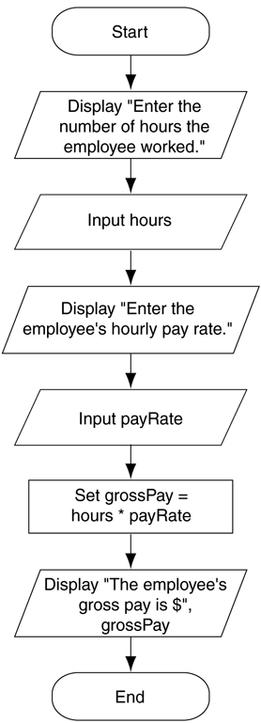
2.1 Designing a Program
Figure 2.2 Flowchart for the pay calculating program
Flowcharts
A diagram that graphically depicts the steps that take place in a program
Terminator used for start and stop
Parallelogram used for input and output
Rectangle used for processes

Slide 11
2.2 Output, Input, and Variables
Output – data that is generated and displayed
Input – data that a program receives
Variables – storage locations in memory for data
Computer programs typically follow 3 steps
Input is received
Some process is performed on the input
Output is produced

Slide 12
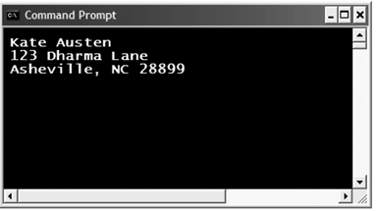
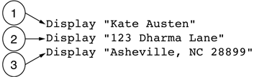
2.2 Output, Input, and Variables
Display is the keyword to show output to the screen
Sequence – lines execute in the order they appear
String Literals – a sequence of characters
Figure 2-4 The statements execute in order
Figure 2-5 Output of Program 2-1

Slide 13
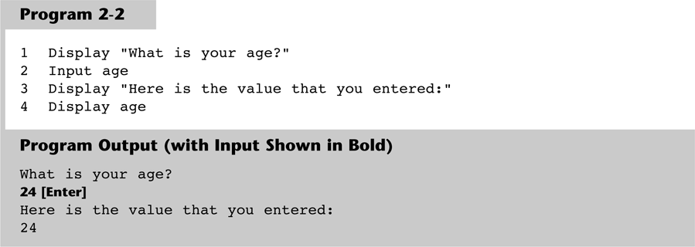
2.2 Output, Input, and Variables
Input is the keyword to take values from the user of the program
It is usually stored in variables

Slide 14
2.2 Output, Input, and Variables
Programmers can define variable names following certain rules
Must be one word, no spaces
Generally, punctuation characters are avoided
Generally, the first character cannot be a number
Name a variable something that indicates what may be stored in it
camelCase is popular naming convention

Slide 15
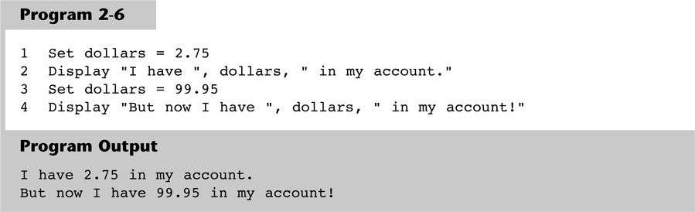
2.3 Variable Assignment & Calculations
Variable assignment does not always have to come from user input, it can also be set through an assignment statement
Set price = 20

Slide 16
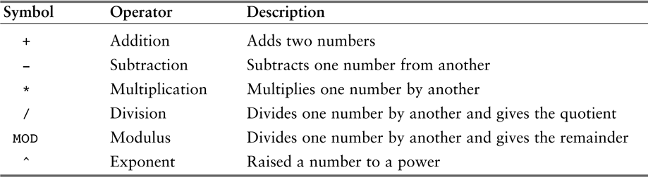
2.3 Variable Assignment & Calculations
Calculations are performed using math operators
The expression is normally stored in variables
Set sale = price – discount
Table 2-1 Common math operators

Slide 17
2.4 Variable Declarations & Data Types
A variable declaration includes a variable’s name and a variable’s data type
Data Type – defines the type of data you intend to store in a variable
Integer – stores only whole numbers
Real – stores whole or decimal numbers
String – any series of characters
Declare Real grossPay

Slide 18
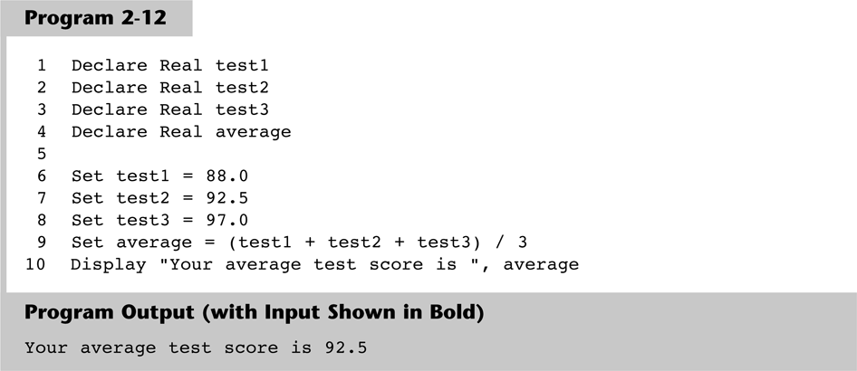
2.4 Variable Declarations & Data Types
For safety and to avoid logic errors, variables should be initialized to 0 or some other value

Slide 19
2.5 Named Constants
A named constant is a name that represents a value that cannot be changed
Makes programs more self explanatory
If a change to the value occurs, it only has to be modified in one place
Constant Real INTEREST_RATE = 0.069

Slide 20
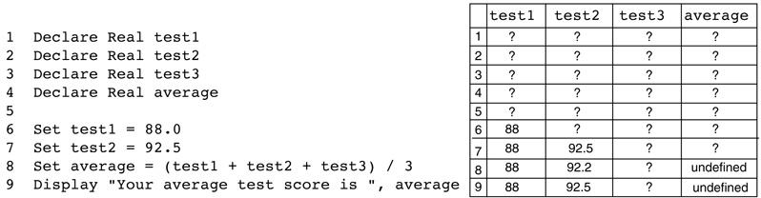
2.6 Hand Tracing a Program
Hand tracing is a simple debugging process for locating hard to find errors in a program
Involves creating a chart with a column for each variable, and a row for each line of code
Figure 2-14 Program with the hand trace chart completed

Slide 21
2.7 Documenting a Program
External documentation describes aspects of the program for the user, sometimes written by a technical writer
Internal documentation explains how parts of the program works for the programmer, also known as comments
// comments are often distinguished within
// the program with line comments

